Slide 1
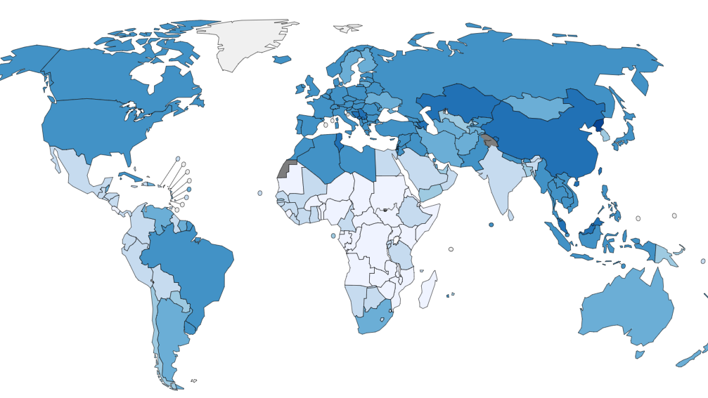
Geo Health Vis
Geospatial based Health Data Visualization

Slide 2

Group - 10
Team Members:
Pavan Gopi Praneeth Gidda
Rakesh Dulam
Ramya Reddy

Slide 3

Problem Statement
Geo Health Vis is a healthcare data visualization tool that allows for a clear representation of medical diseases and their prevalence across the world, especially cancer.
It enables the comparison of healthcare statistics between different locations through various visualization techniques, such as scatterplots, histograms, and bar plots.
The lack of effective communication and comprehension of global health statistics impedes the development of evidence-based public health policies.
The development of Geo Health Vis can potentially help overcome this obstacle and support the creation of evidence-based public health policies.

Slide 4

Why is Visualization needed?
It allows us to display complex healthcare data in a way that is easy to understand and interpret
Visualization enables us to identify patterns, trends, and relationships in the data that might not be apparent in a table or written report.
Additionally, visualization facilitates effective communication of healthcare statistics and promotes data-driven decision-making in healthcare policies.
By using geospatial visualization techniques and different types of plots, we can represent the healthcare data accurately and comprehensively, making it accessible to a wider audience, including policymakers, researchers, and the general public.

Slide 5
Project EXPECTATIONS
Medical disease statistics of different locations across the world.
Enable easy comprehension of healthcare statistics by representing them in different visual forms such as pie charts, scatterplots, histograms, line plots, etc.
Provide a comparison of healthcare statistics of different locations, allowing users to identify trends and make informed decisions.
Enable users to access and explore healthcare data through an intuitive and user-friendly interface.
Promote data-driven decision-making in healthcare policies and aid researchers in developing evidence-based public health policies.

Slide 6

Datasets
Geojson Datasets for locating the areas.
Medical Datasets.

Slide 7
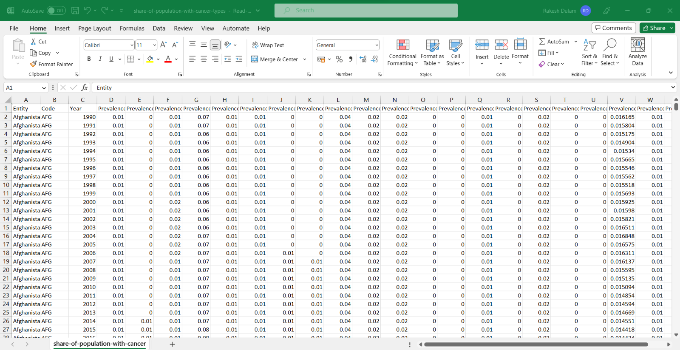
Cancer Dataset:

Slide 8
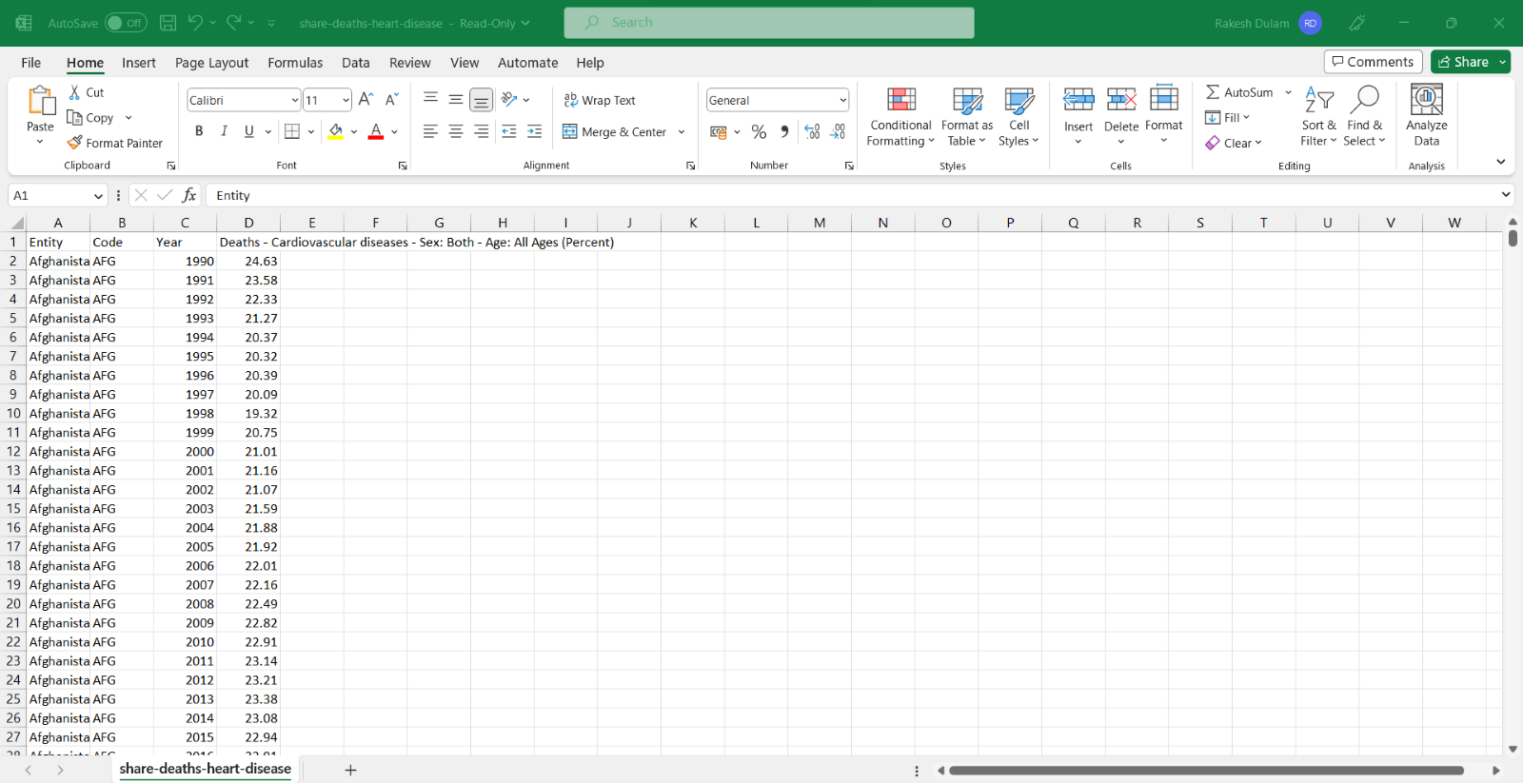
HEART DISEASE Dataset:

Slide 9
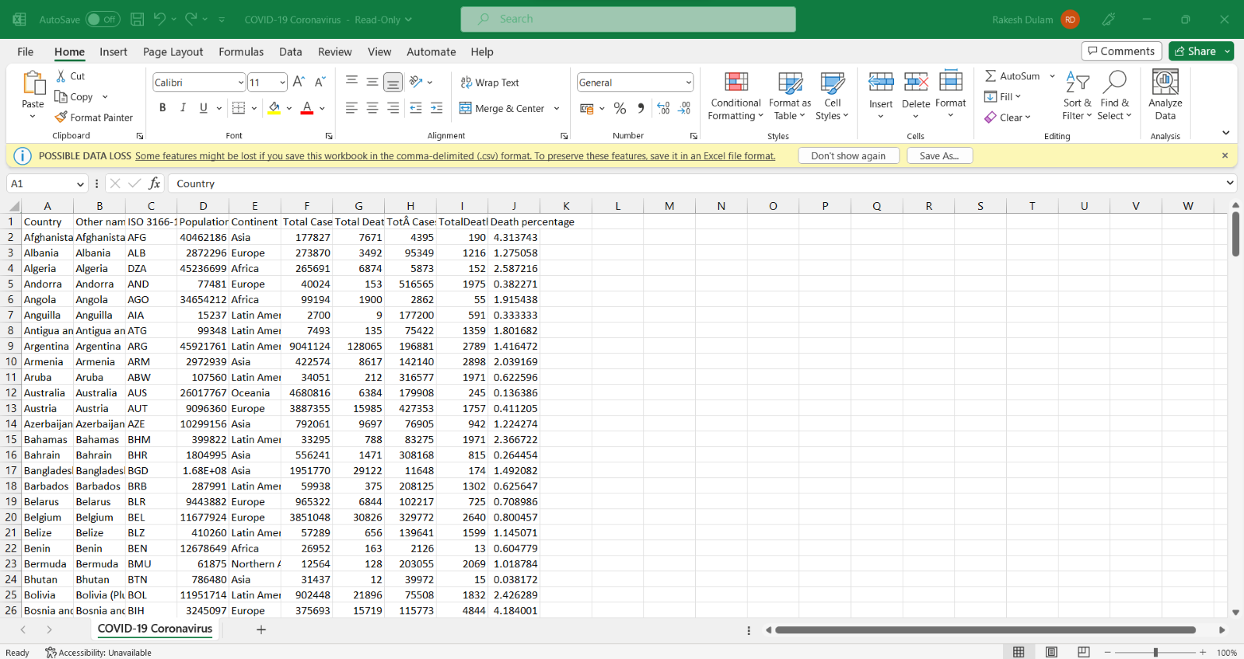
COVID-19 Dataset:

Slide 10
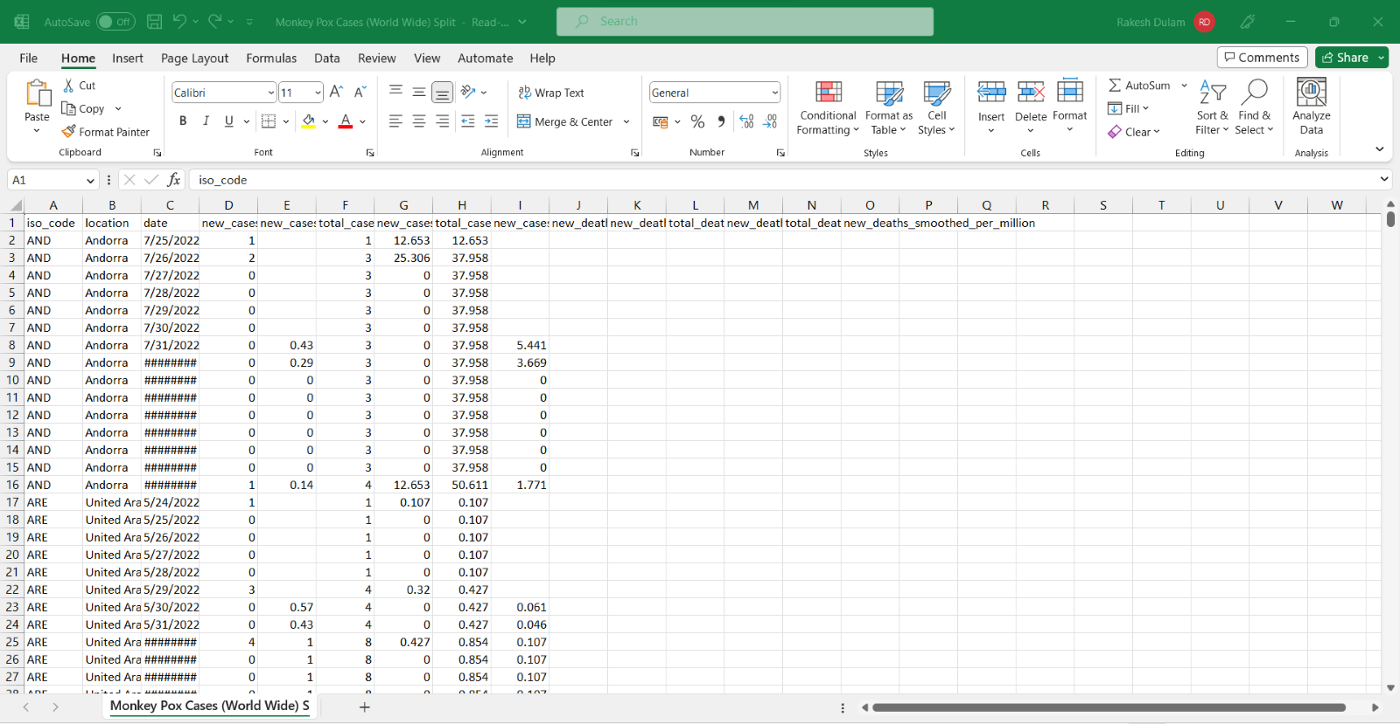
MONKEY POX Dataset:

Slide 11
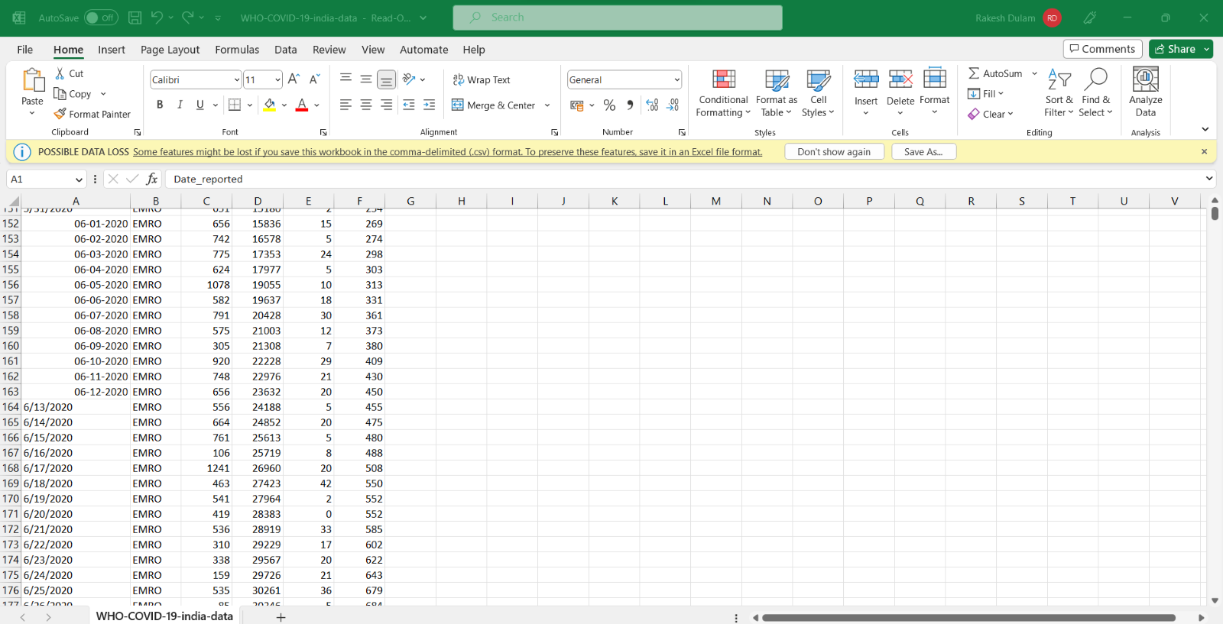
COMPARISON: COVID-19 Dataset FOR INDIA:

Slide 12
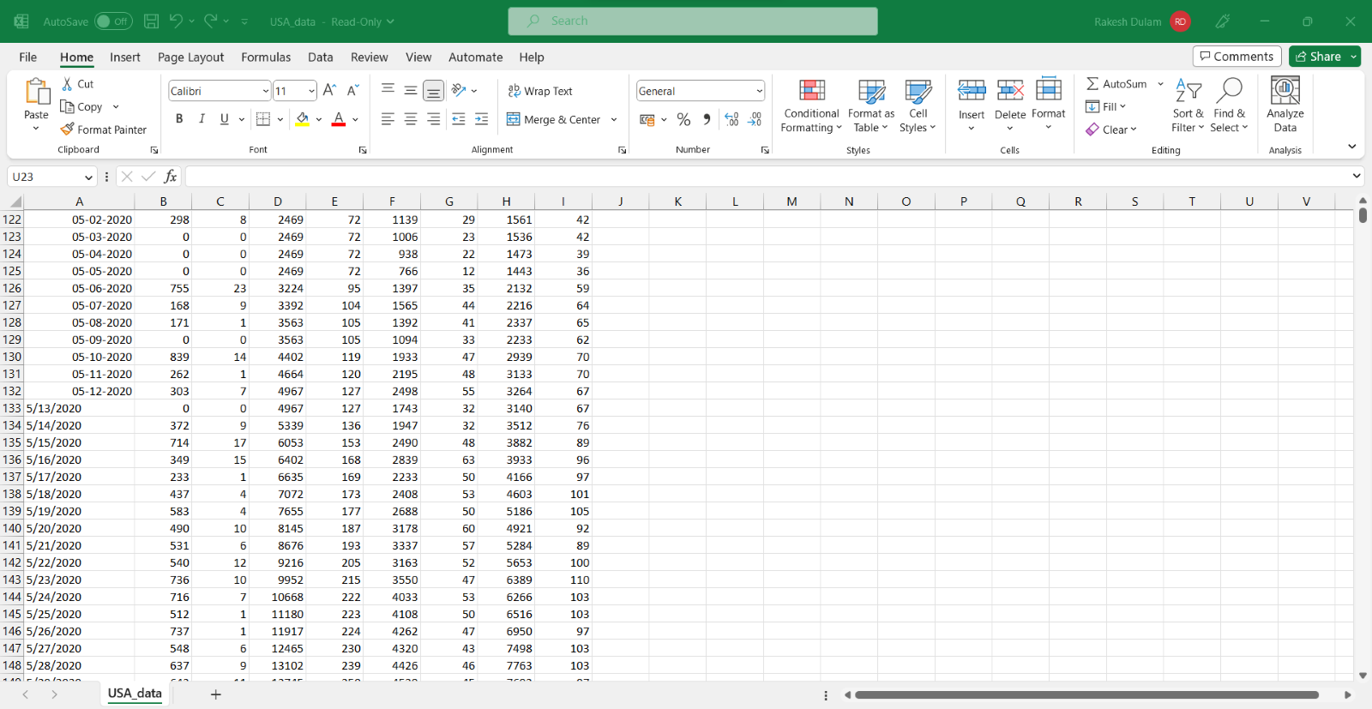
COMPARISON: COVID-19 Dataset FOR USA:

Slide 13
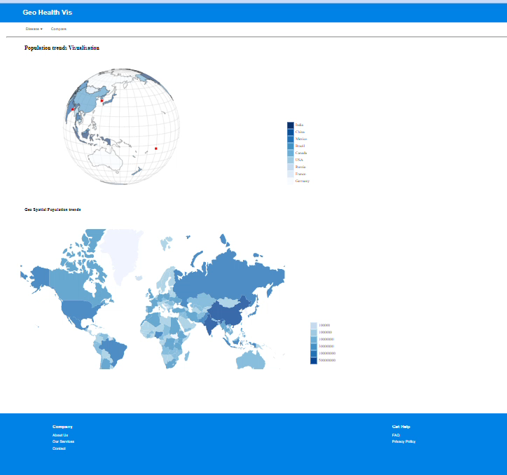
Geo HEALTH VIS PORTAL

Slide 14
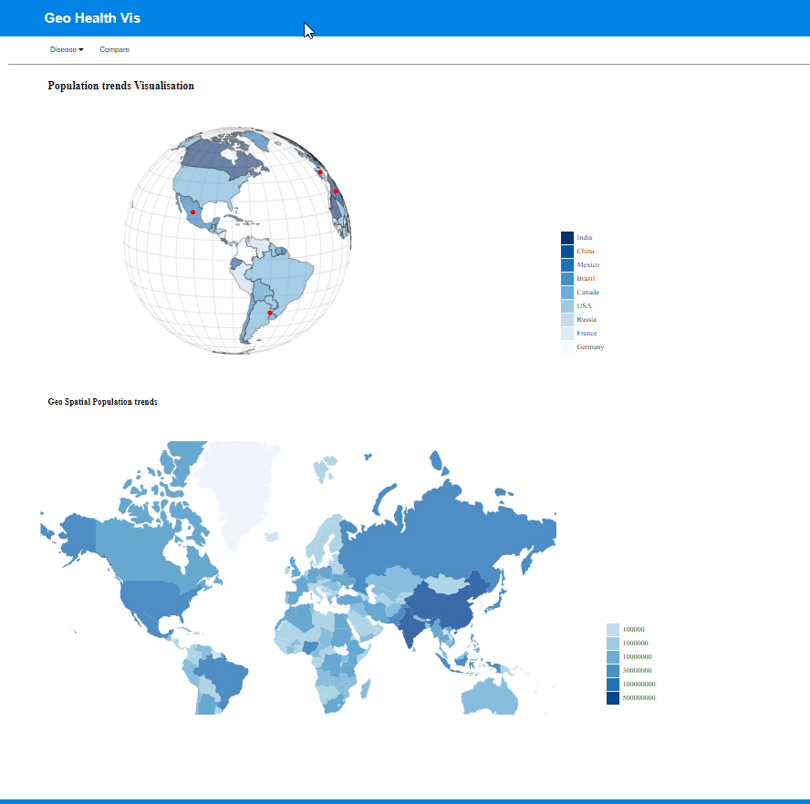
Visualization of various datasets

Slide 15
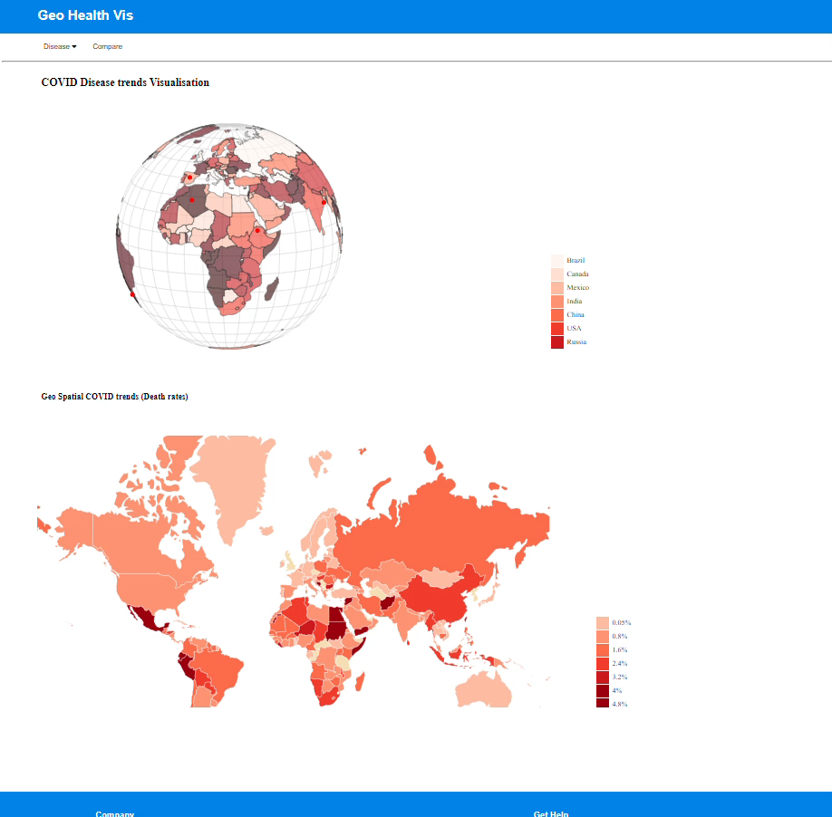
Visualizing statistics

Slide 16
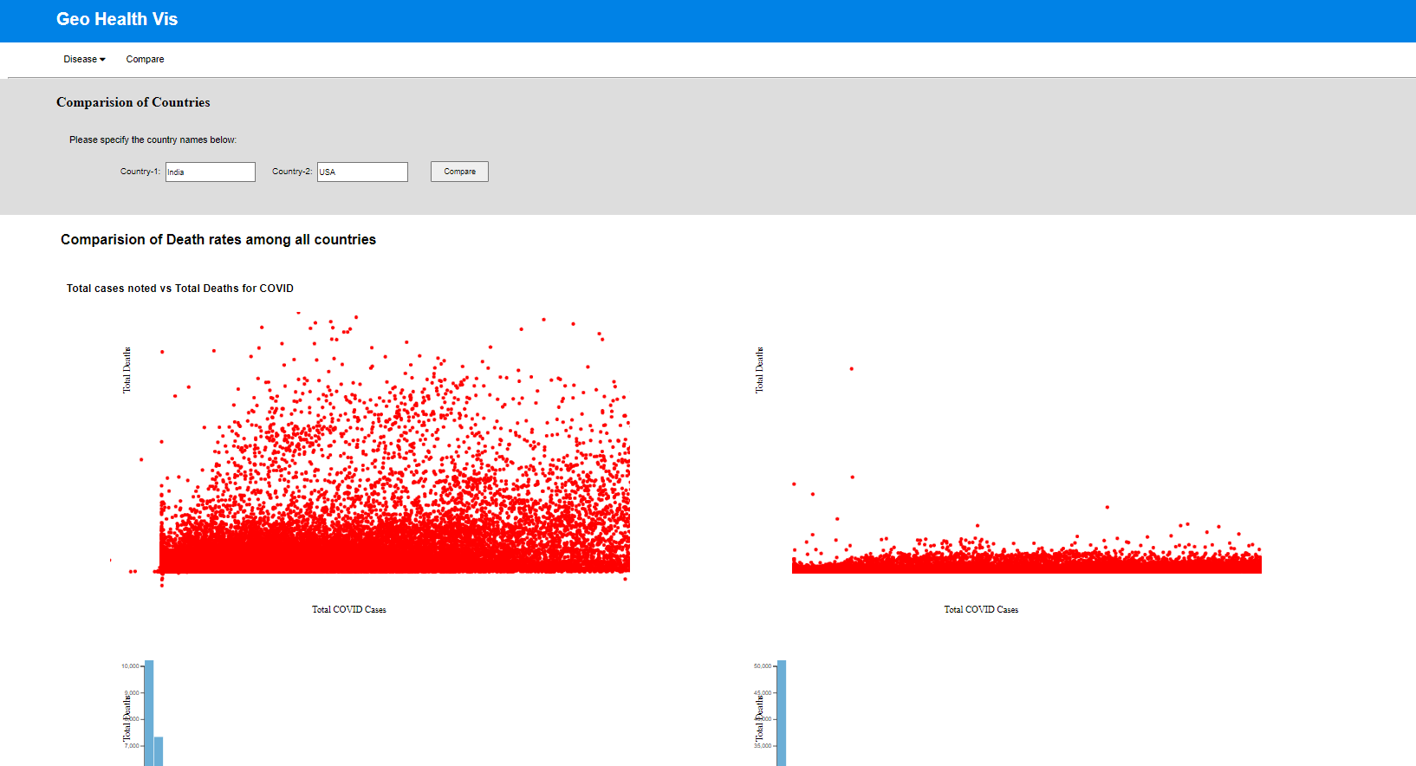
Applying COMPARE filters for visualization

Slide 17
GOALS:
The purpose of the Geo Health Viz is to provide users with multiple visualizations related to health, including population trends and disease trends such as Cancer, Heart disease, Monkey Pox, and COVID-19.
To provide users with visualizations that help them understand the impact of diseases on different populations and how they vary over time.
To enable users to explore the relationship between population density and disease prevalence, and how this varies across different regions of the world.
To provide users with a tool to compare the health outcomes of different countries and identify areas for improvement.
To raise awareness about the global impact of various diseases and help users understand how it has affected different countries and regions.

Slide 18
LIMITATIONS:
Data Availability: If data is not available for certain regions or countries, or if the data is outdated or inaccurate, the tool may not provide an accurate representation of healthcare statistics.
Platform Compatibility: The tool may not be compatible with all web browsers or mobile devices, which could limit its accessibility to certain users.
User Feedback: The tool may not meet the needs and expectations of all users. User feedback and user testing may be necessary to identify potential issues and areas for improvement.

Slide 19
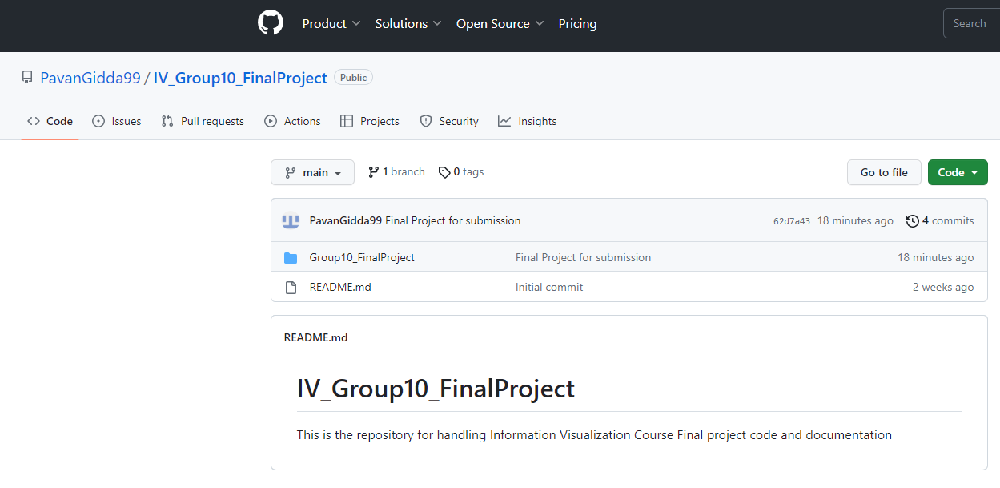
GIT resources
Git Link - https://github.com/PavanGidda99/IV_Group10_FinalProject
Git repository - https://github.com/PavanGidda99/IV_Group10_FinalProject.git

Slide 20

Team Contribution
Project decision – Group
Geospatial visualizations – Ramya
Visualization Portal (Reading of inputs and display of primary statistics) – Rakesh
Statistics display and visualizations for comparison of statistics - Praneeth
Code, Dataset, Report – Group

Slide 21


